Slide 1
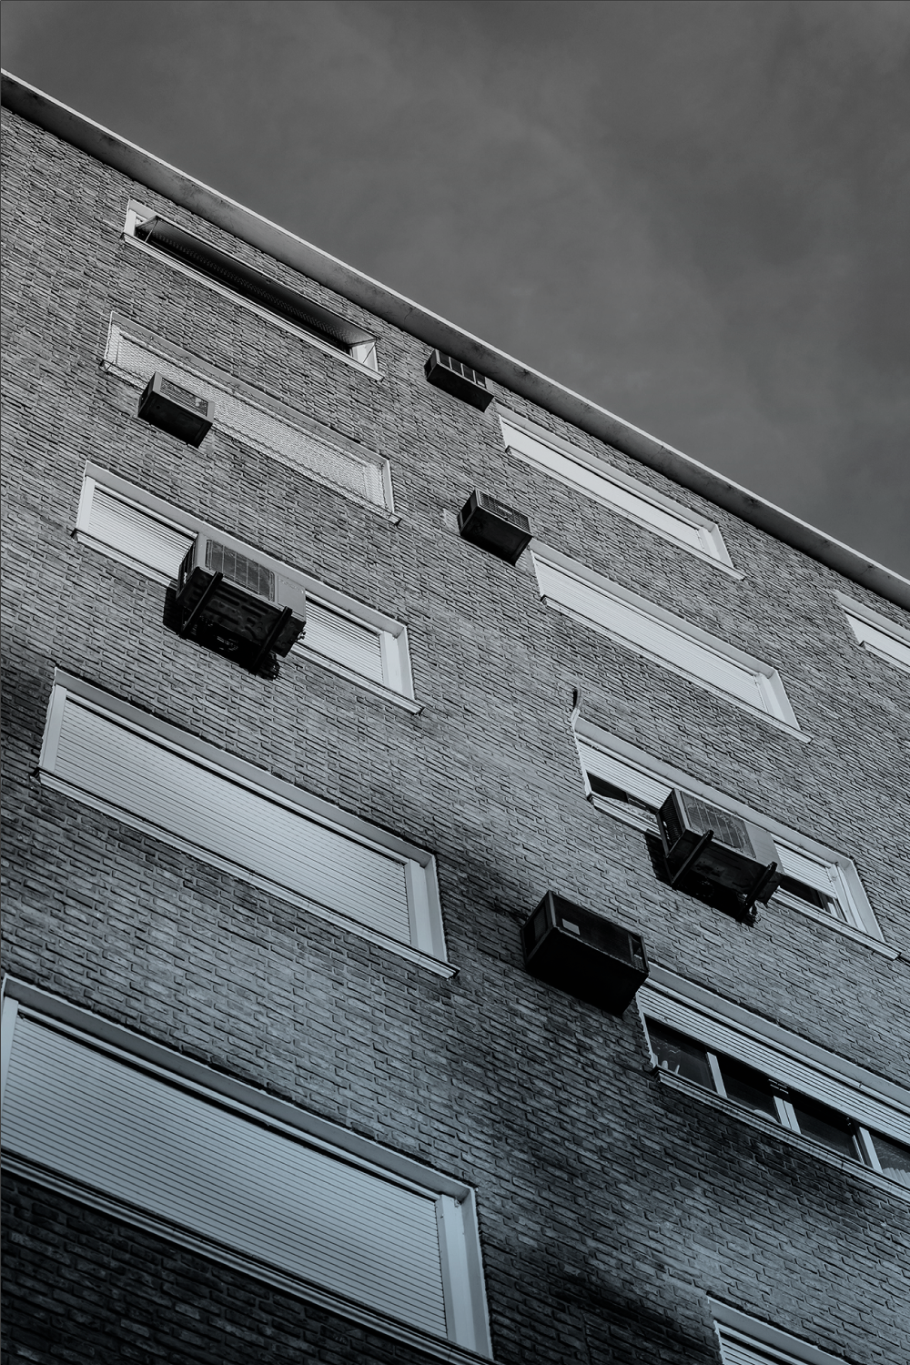
AIRLINE TWITTER SENTIMENT ANALYSIS
BY KAYLA CHO

Slide 2
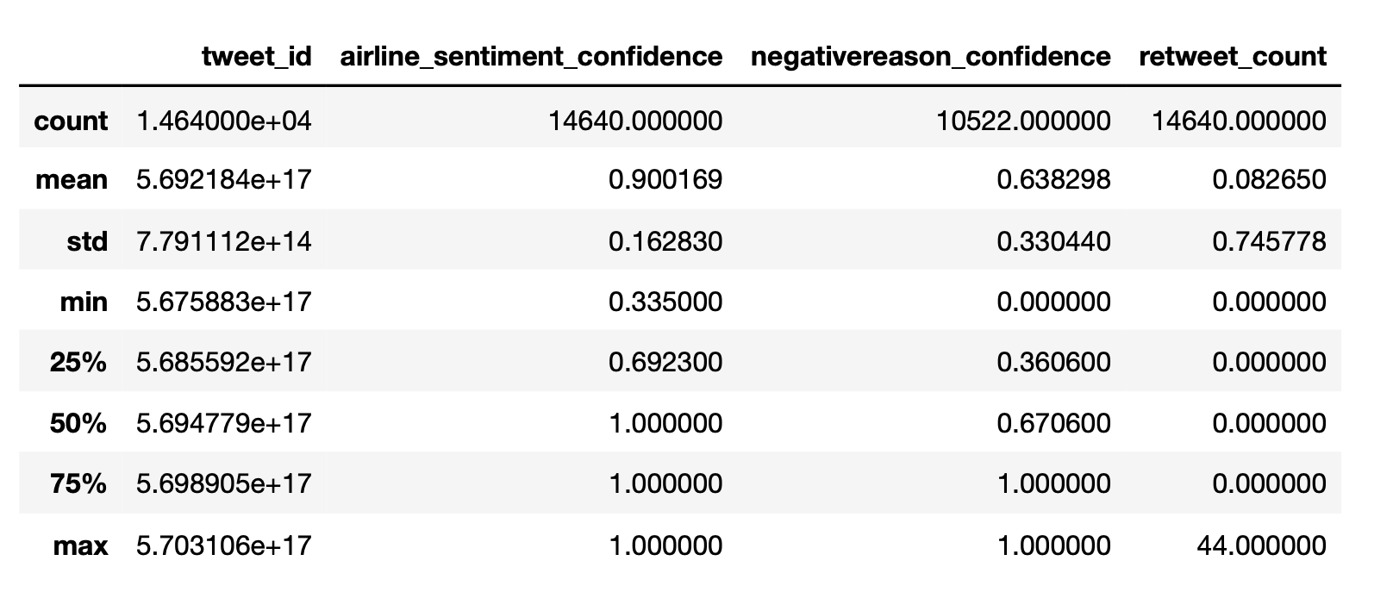
INTRODUCTION
MOTIVATION
To understand Twitter sentiments and tweets written about airlines in February 2015.
THE DATA SET
Tweets from February 2015
14,640 Entries
15 Columns
Airline Sentiment Confidence
Range ≈ 0.34 – 1.0
Mean ≈ 0.9
Negative Reason Confidence
Range ≈ 0.0-1.0
Mean ≈ 0.64
SUMMARY STATISTICS

Slide 3
TWEET ACTICITY IN FEBRUARY 2015
Tweets primarily from February 16^{th-} 24th 2015
February 21st – 24th Tweets about American rises
Tweets about Delta & United were constantly posted during this time
Little to no discussion about Virgin America

Slide 4
TWEET ACTICITY IN FEBRUARY 2015

Slide 5
TWEET SENTIMENT BY HOUR

Slide 6
AIRLINE SENTIMENT CONFIDENCE
Range: ≈ 0.59-0.73
Median ≈ 0.66
Distribution of Twitter sentiment confidence is consistent across the different types of sentiments
Some outliers- slightly more confident in determining sentiment of negative tweets.
Approximately 66% confident that the tweet is put into the correct sentiment.

Slide 7
AIRLINE SENTIMENT CONFIDENCE BY AIRLINE

Slide 8
TWITTER SENTIMENT BY AIRLINE

Slide 9
NEGATIVE REASONS FOR TWEETS
Jupiter is a gas giant and the biggest planet in the Solar System

Slide 10
TOP 3 NEGATIVE REASONS FOR EACH AIRLINE
MARS
SATURN
Saturn is the ringed planet and a gas giant
JUPITER
It’s the biggest planet in the Solar System
To modify this graph, click on it, follow the link, change the data and paste the new graph here
Notes:
Can’t Tell was the third most popular negative reason for all of them but we chose to ignore it because it doesn’t provide insight into specific airline problems. This is one area we could look at in the future to determine what topics the sentiment analysis was unable to categorize.

Slide 11
AIRLINE RETWEETS
Jupiter is a gas giant and the biggest planet in the Solar System

Slide 12
CONCLUSION
NEPTUNE
JUPITER
MARS
Neptune is the farthest planet from the Sun
It’s a gas giant and the biggest planet of them all
Despite being red, Mars is actually a cold place

Slide 13
MAJOR REQUIREMENTS
NEPTUNE
JUPITER
MARS
Neptune is the farthest planet from the Sun
It’s a gas giant and the biggest planet of them all
Despite being red, Mars is actually a cold place

Slide 14
EXECUTIVE SUMMARY
GOAL 1
GOAL 2
GOAL 3
GOAL 4
It’s a giant and the biggest planet in the Solar System
Despite being red, Mars is actually a very cold place
Venus is the second planet from the Sun and is very hot
Mercury is the closest planet to the Sun and is small

Slide 15
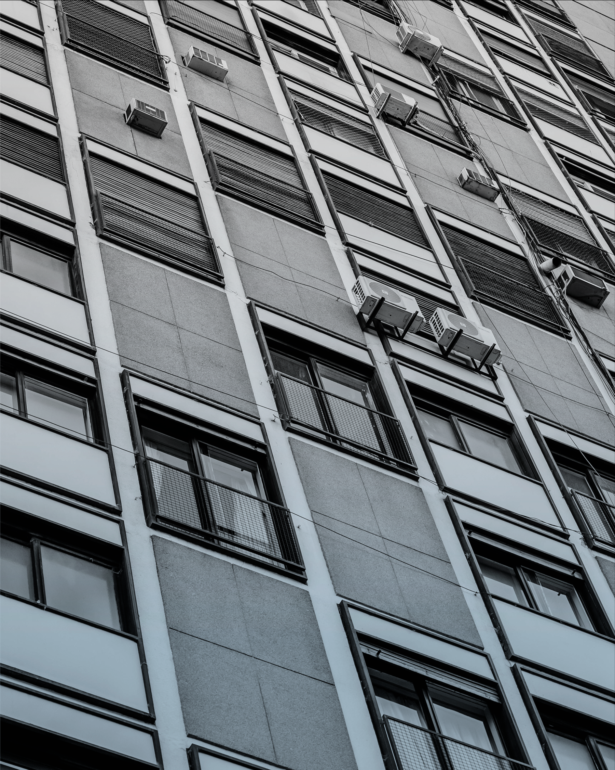
THANKS!
Do you have any questions? youremail@freepik.com +91 620 421 838
yourcompany.com
Please keep this slide for attribution

Slide 16
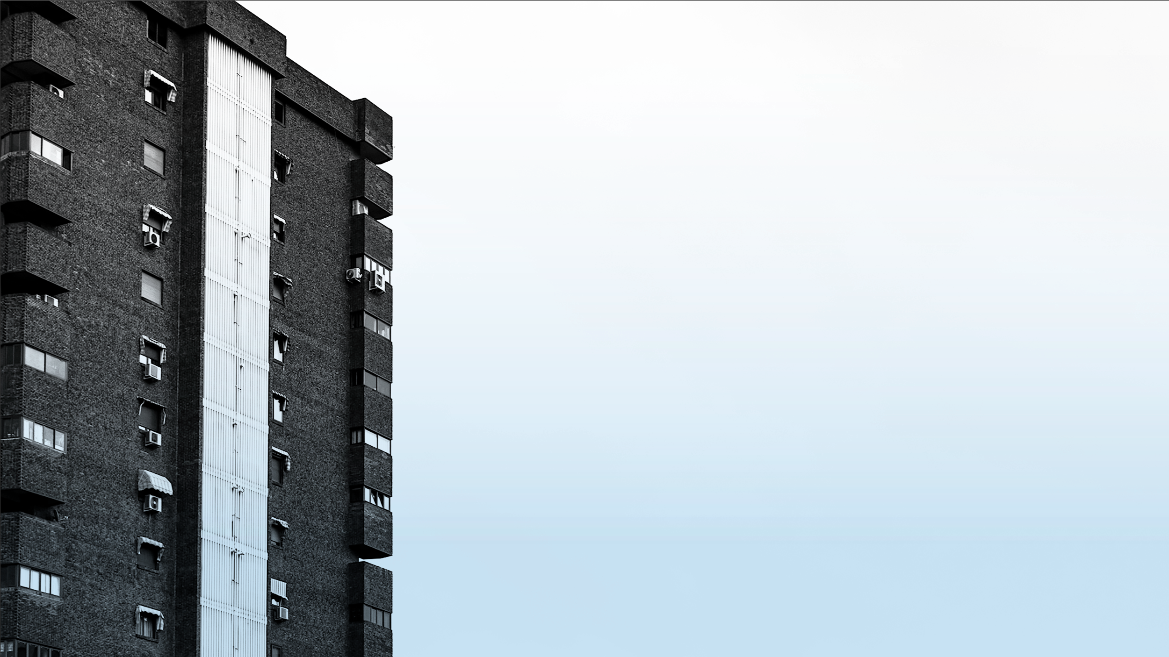
APPENDIX

Slide 19
APPENDIX A
Please keep this slide for attribution

Slide 20
APPENDIX B: GOLD
Please keep this slide for attribution

Slide 21
DATA ASSESSMENT
Issues
Quality
Structure
Findings

Slide 22
ACTION STEPS
Issues
Quality
Structure
Findings

Slide 23
TABLE OF CONTENTS
1
THE PROJECT
PROJECT STAGES
3
Here you could describe the topic of the section
Here you could describe the topic of the section
PROJECT GOALS
SNEAK PEEK
2
4
Here you could describe the topic of the section
Here you could describe the topic of the section

Slide 24
OUR COMPANY
Mercury is only a bit larger than the Moon. The planet’s name has nothing to do with the liquid metal, since Mercury was named after the Roman messenger god

Slide 25
Instructions for use
In order to use this template, you must credit Slidesgo by keeping the Thanks slide.
You are allowed to:
- Modify this template.
- Use it for both personal and commercial projects.
You are not allowed to:
- Sublicense, sell or rent any of Slidesgo Content (or a modified version of Slidesgo Content).
- Distribute Slidesgo Content unless it has been expressly authorized by Slidesgo.
- Include Slidesgo Content in an online or offline database or file.
- Offer Slidesgo templates (or modified versions of Slidesgo templates) for download.
- Acquire the copyright of Slidesgo Content.
For more information about editing slides, please read our FAQs or visit Slidesgo School:
https://slidesgo.com/faqs and https://slidesgo.com/slidesgo-school

Slide 26
Fonts & colors used
This presentation has been made using the following fonts:
Hammersmith One
(https://fonts.google.com/specimen/Hammersmith+One)
Istok Web
(https://fonts.google.com/specimen/Istok+Web)
#000000
#434343
#595959
#666666
#999999
#b7b7b7
#eeeeee
#ffffff
#cfe2f3

Slide 27





Storyset
Create your Story with our illustrated concepts. Choose the style you like the most, edit its colors, pick the background and layers you want to show and bring them to life with the animator panel! It will boost your presentation. Check out How it Works.
Pana
Amico
Bro
Rafiki
Cuate

Slide 28
Use our editable graphic resources...
You can easily resize these resources without losing quality. To change the color, just ungroup the resource and click on the object you want to change. Then, click on the paint bucket and select the color you want. Group the resource again when you’re done. You can also look for more infographics on Slidesgo.

Slide 31
JANUARY
FEBRUARY
MARCH
APRIL
MAY
JUNE
PHASE 1
Task 1
Task 2
PHASE 2
Task 1
Task 2
JANUARY
FEBRUARY
MARCH
APRIL
PHASE 1
Task 1
Task 2

Slide 34
...and our sets of editable icons
You can resize these icons without losing quality.
You can change the stroke and fill color; just select the icon and click on the paint bucket/pen.
In Google Slides, you can also use Flaticon’s extension, allowing you to customize and add even more icons.

Slide 35
Educational Icons
Medical Icons

Slide 36
Business Icons
Teamwork Icons

Slide 37
Help & Support Icons
Avatar Icons

Slide 38
Creative Process Icons
Performing Arts Icons

Slide 39
Nature Icons

Slide 40
SEO & Marketing Icons

Slide 41


